Slide 1

QA – Automation Tester Certification
QA – Automation Tester Certification
Test Automation Engineer – Preparation Course – Session 3
Test Automation Engineer – Preparation Course – Session 03

Slide 2
QA – Automation Tester Certification
Content
01. UI Web based application Automation
Selenium Webdriver, BDD Gherkin Language, Specflow, Page Object Model
02. Backend API Rest Automation
GET / POST / PUT / DELETE requests
Postman, ResponsibilityChain pattern
03. UI Android application Automation
Appium, Locators in Android
04. Continuous Integration over Azure Environment
Vstest Executor
Pipelines
Reporting
Selenium Grid

Slide 3

01. UI Web based application Automation
Selenium: How to Start a New Project
Appium
Server & Installation

Slide 4
03. UI Android Automation
3.1 Appium
Appium is an open-source tool for automating native, mobile web, and hybrid applications on iOS mobile, Android mobile, and Windows desktop platforms.
Client/Server Architecture: Appium is at its heart a webserver that exposes a REST API. It receives connections from a client, listens for commands, executes those commands on a mobile device, and responds with an HTTP response representing the result of the command execution.
Session: Automation is always performed in the context of a session. Clients initiate a session with a server in ways specific to each library, but they all end up sending a POST /sesión request to the server, with a JSON object called the 'desired capabilities' object.
Desired Capabilities: Desired capabilities are a set of keys and values (i.e., a map or hash) sent to the Appium server to tell the server what kind of automation session we're interested in starting up.

Slide 5
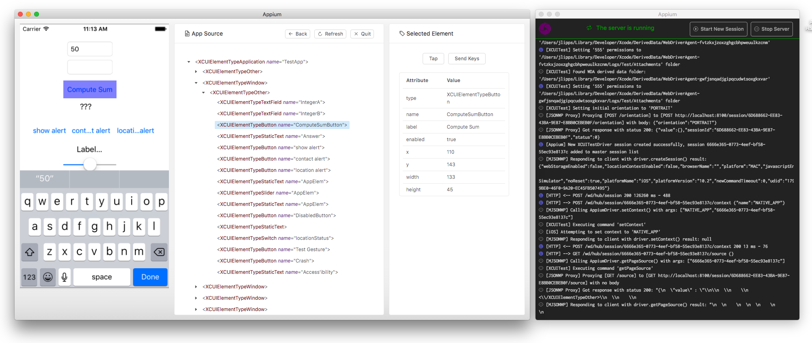
03. UI Android Automation
3.2 Appium Desktop
Appium Desktop is an app for Mac, Windows, and Linux which gives you the power of the Appium automation server in a beautiful and flexible UI

Slide 6
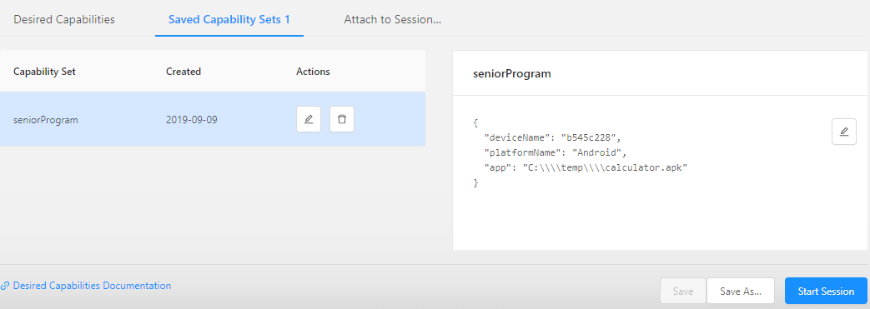
03. UI Android Automation
3.3 Appium: Capabilities

Slide 7
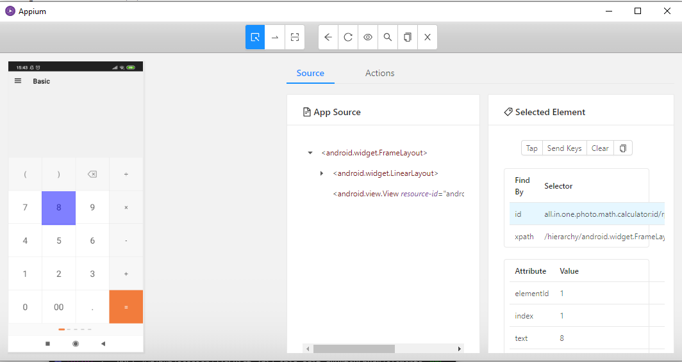
03. UI Android Automation
3.4 Appium: Locators

Slide 8
03. UI Android Automation
3.4 Appium: Locators
By ID
[FindsBy(How = How.Id, Using = "iconNurse")]
private IWebElement emoticonNurse { get; set; }
By XPATH
[FindsBy(How = How.XPath, Using = "//*[@resource-id='all.in.one.photo.math.calculator:id/d1']")]
private IWebElement BtnSolve { get; set; }
By CLASSNAME, TEXT
[FindsBy(How = How.XPath, Using = "//*[(@text='All your results’) and (@class='android.widget.TextView')]")]
private IWebElement txtPastResultsHeader { get; set; }

Slide 9
01. UI Web based application Automation
Selenium: How to Start a New Project
PRACTICE
Android Calculator

Slide 10
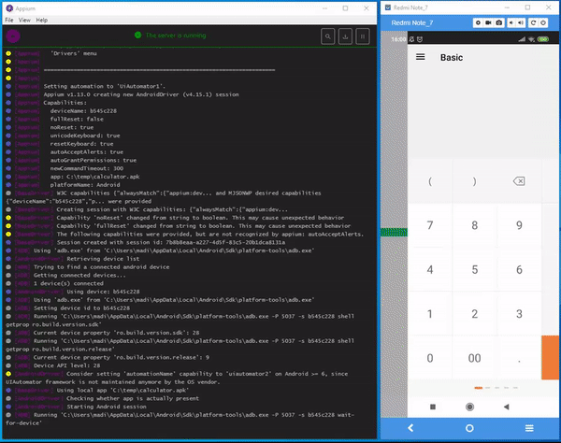
03. UI Android Automation
3.2 Practice: Calculator

Slide 11
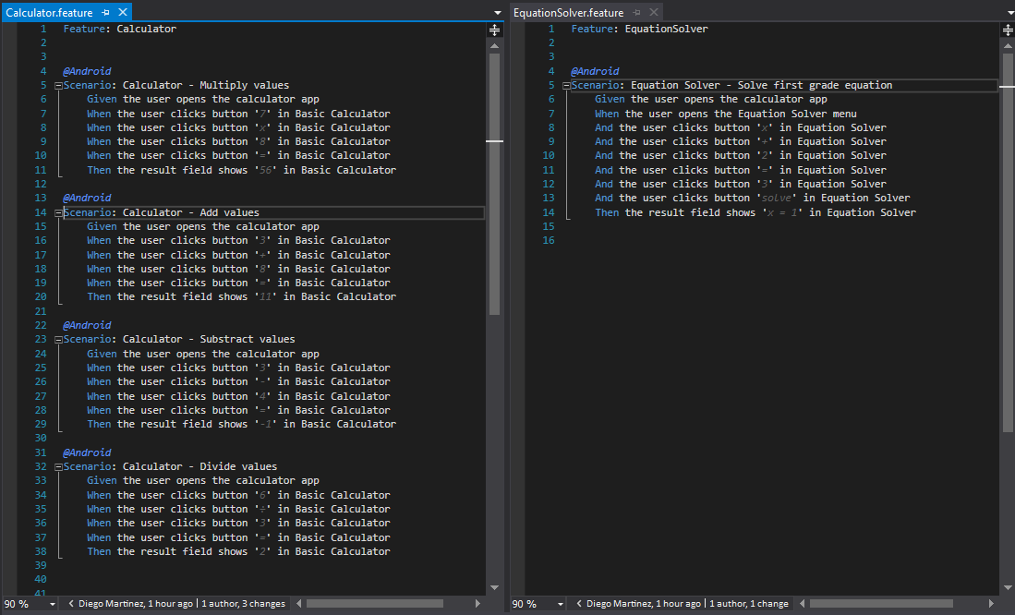
03. UI Android Automation
3.2 Practice: Calculator

Slide 12

Diego Martínez Gilabert
diegomartinezgilabert@erni-espana.es

